Slide 1
Beautiful America
Famous landmarks of our country…

Slide 2
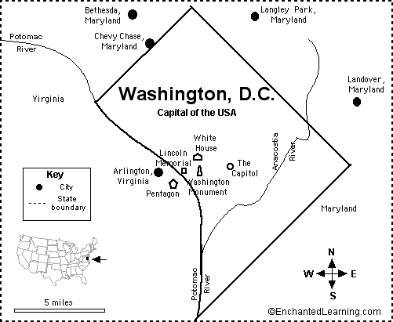
Washington D.C.
Washington D.C. was made the capital of the United States in 1790. It’s not located in a state but in a special area of land owned by the U.S. government called the District of Columbia. This city was named after George Washington.

Slide 3
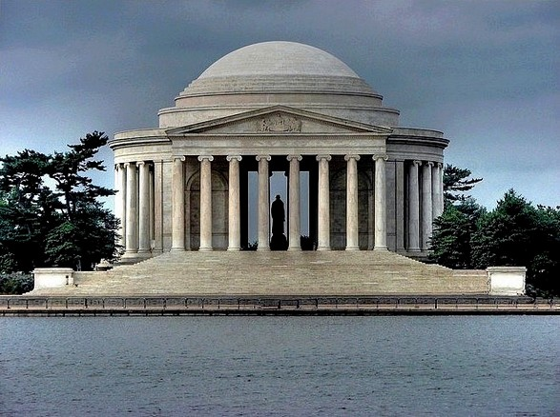
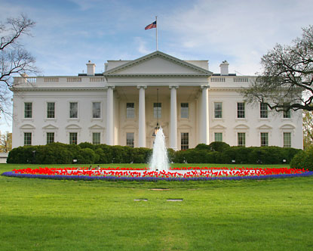
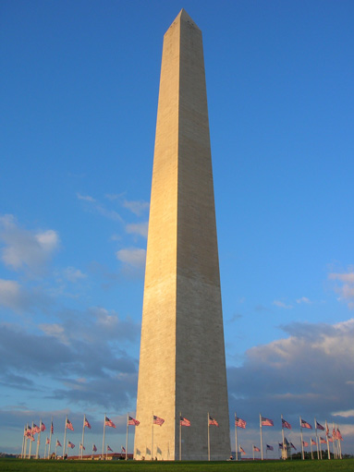
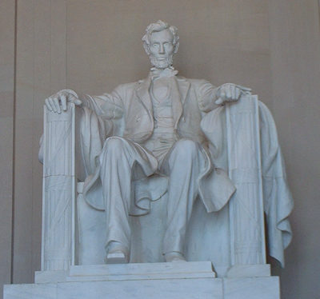
Washington D.C. is filled with many famous landmarks like the White House, the Lincoln Memorial, the Washington Monument, and the Thomas Jefferson Memorial.

Slide 4
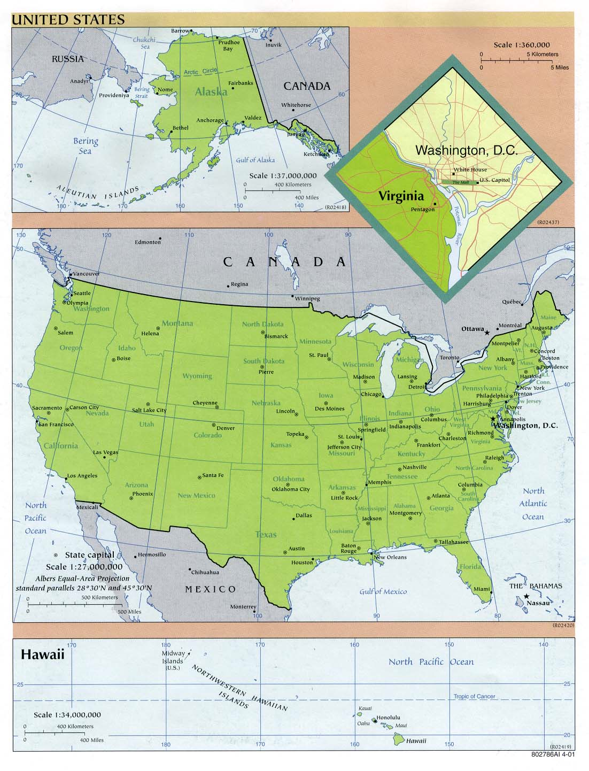
Here’s Washington D.C. on the map!

Slide 5
The Statue of Liberty
The Statue of Liberty was built in France and was given to the United States as a gift of friendship and freedom. It is located on Liberty Island in New York Harbor and is made of copper. The Statue of Liberty stands 302 feet tall and took 10 years to make!

Slide 6
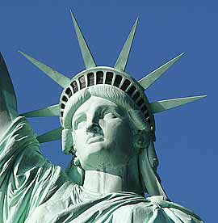
Here’s a map of New York!

Slide 7
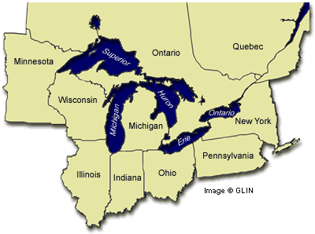
The Great Lakes include Lakes Huron, Ontario, Michigan, Erie, and Superior (HOMES). Together, they make up 1/5 of the world’s supply of fresh water.
The Great Lakes

Slide 8
The St. Louis Arch
Represents all the pioneers who moved west to build our country from ocean to ocean
Designed by Eero Saarinen and completed in 1867
Arch stands 630 ft. tall
Visitors can enter the Arch from an underground visitor’s center and travel to the top in a 40-passenger tram.

Slide 9
Mount Rushmore
Mount Rushmore is located in S. Dakota and took 14 years to complete!
Sculptor Gutzon Borglum began drilling into the 5,725 ft. mountain in 1927. It cost $1 million to complete.
Theodore Roosevelt
George Washington
Thomas Jefferson
Abraham Lincoln

Slide 10
The Mississippi River
The Mississippi River is 2,320 miles long from its source at Lake Itasca in Minnesota to the Gulf of Mexico.
It’s the second longest river in the United States and has over 241 species of fish living in it!
This river serves as a partial boundary to ten states.
Many explorers used this river to travel, including Christopher Columbus, who was the first known man to explore this river.

Slide 11
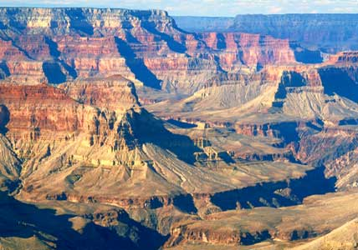
The Grand Canyon
The Grand Canyon (277 miles long) is located in Arizona and is one of the 7 natural wonders of the world. The rocks that make up the walls of the Grand Canyon range from 250 million years old to over 2 billion years old.

Slide 12
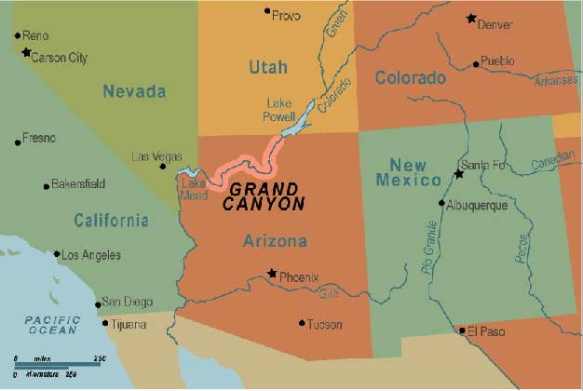
Here’s the Grand Canyon on the map!

Slide 13
The Missouri River
The headwaters of the Missouri River are in the Rocky Mountains near Three Forks, Montana, beginning at the Jefferson and Madison Rivers and joining with the Gallatin River. It flows from Montana through North Dakota, South Dakota, Nebraska, and Missouri where it connects to the Mississippi River in St. Louis.

Slide 14
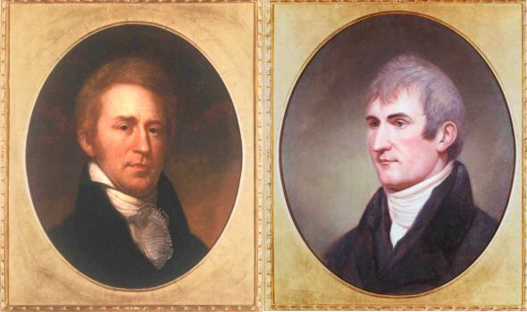
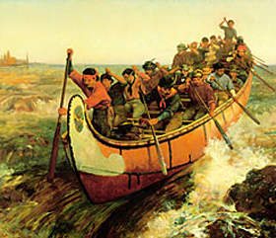
The Missouri River was used by many people to explore and travel like Lewis & Clark, Native Americans, and French explorers.

Slide 15
The Golden Gate Bridge
The Golden Gate Bridge is 1.7 miles long and was completed in 1937. It took 4 years to build. The Bridge links San Francisco with Marin County and can be crossed by car, on bicycle, or on foot. The bridge’s two towers rise 746 feet making them 191 feet taller than the Washington Monument!

Slide 16
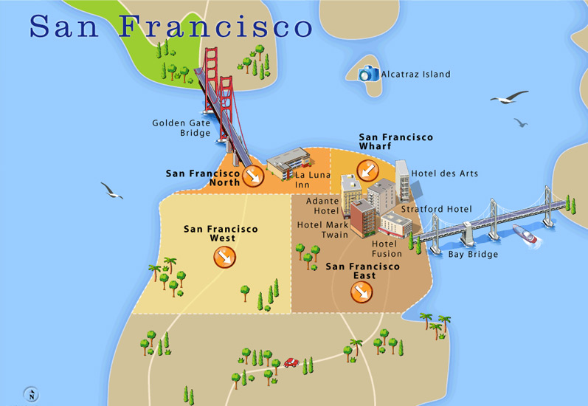
The Golden Gate Bridge is in California. Here’s a map:

Slide 17
The Rocky Mountains
This mountain range stretches for 2,980 miles from Canada to New Mexico. The highest peak is Mount Elbert in Colorado that reaches 14,440 feet above sea level.

Slide 18
The Liberty Bell
Located in Philadelphia, Pennsylvania
A symbol of liberty and justice for America
Cast in London, England in 1752
The Liberty Bell rang when the Congress first signed the Declaration of Independence.
Cracked shortly after its arrival from England to Philadelphia, so local craftsmen recast the bell with metal from the old bell
A third bell was cast by John Pass and John Stowe, so their names are on the bell.
Traditionally, the bell is rung every 4th of July.

Slide 19
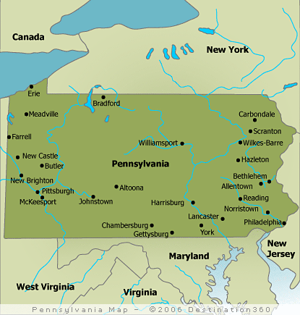
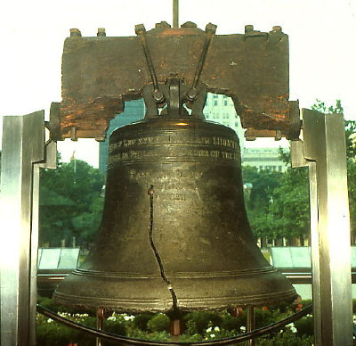
The Liberty Bell is in Philadelphia, Pennsylvania.

Slide 20
The Alamo
The Alamo played an important role in the Texas Revolution. In 1836, Mexican troops attacked the Alamo Mission in San Antonio, TX. Texans fought fearlessly against the Mexicans for 13 days, but they lost the battle. Later, the Mexicans were defeated in the Battle of San Jacinto.

Slide 21
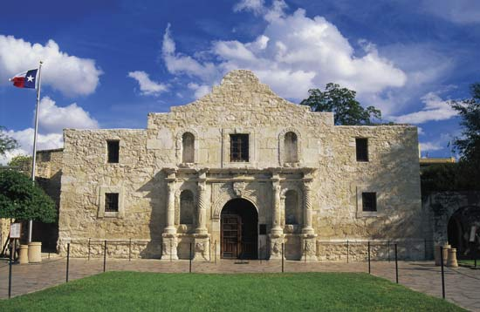
The Alamo is located in San Antonio, Texas.

Slide 22
The Bald Eagle
You can find the bald eagle on the backs of our gold coins, silver dollar, half dollar, and quarter. It represents freedom and was chosen as our symbol because of its long life, strength, and majestic looks.
The bald eagle is our national bird and the only bird unique to North America. They are found throughout most of North America from Alaska and Canada to northern Mexico. About half of the world’s 70,000 bald eagles live in Alaska.

Slide 23
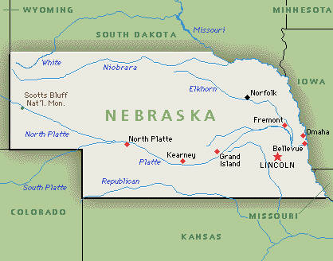
NEBRASKA!!!
NE became the 37th state of the USA on March 1, 1867. Lincoln became the capital of the state on July 29th.

Slide 24
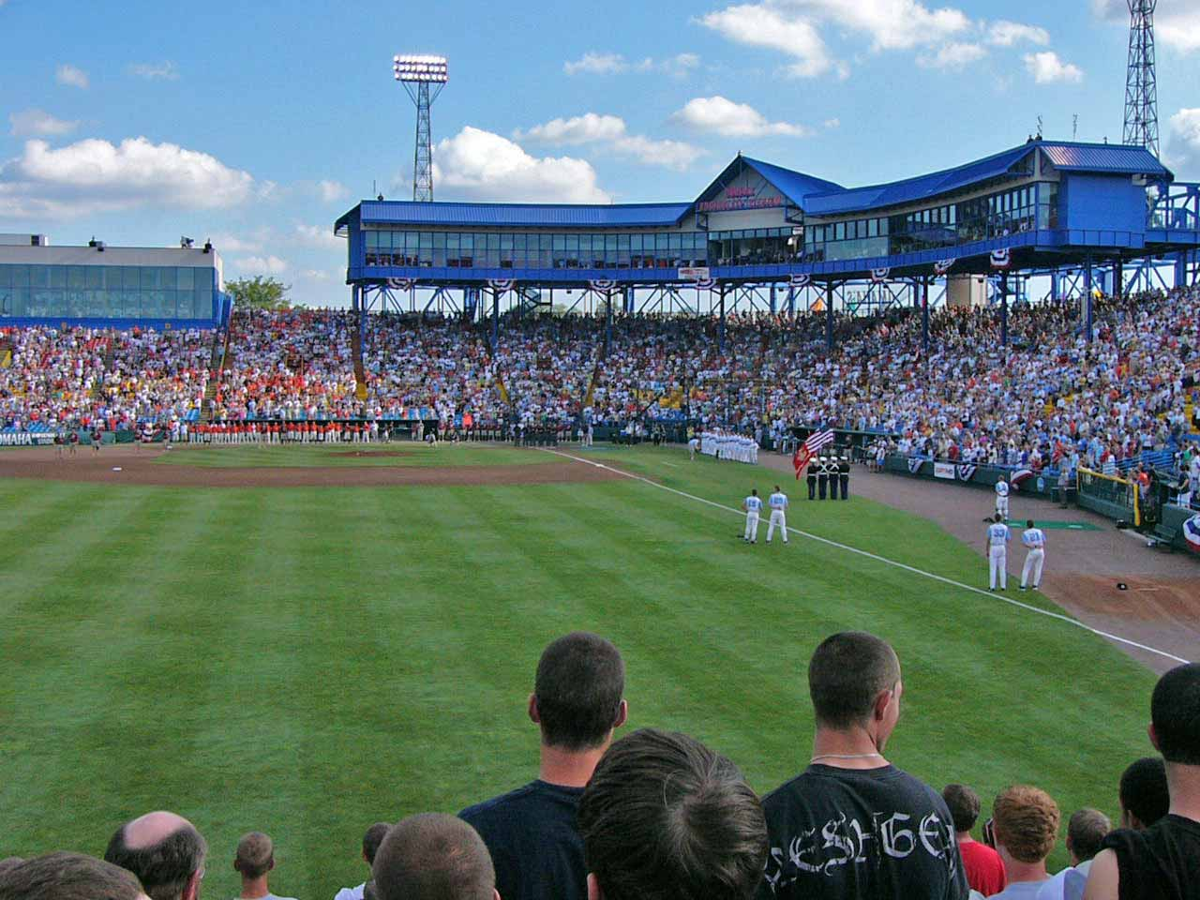
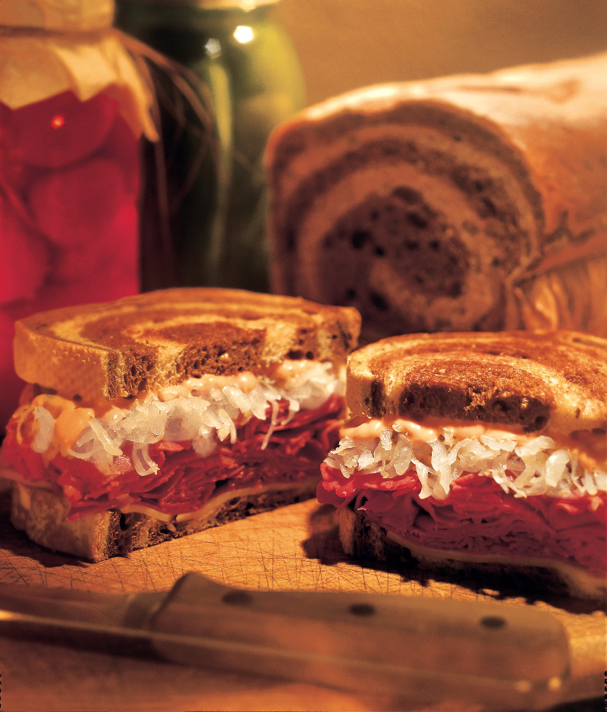
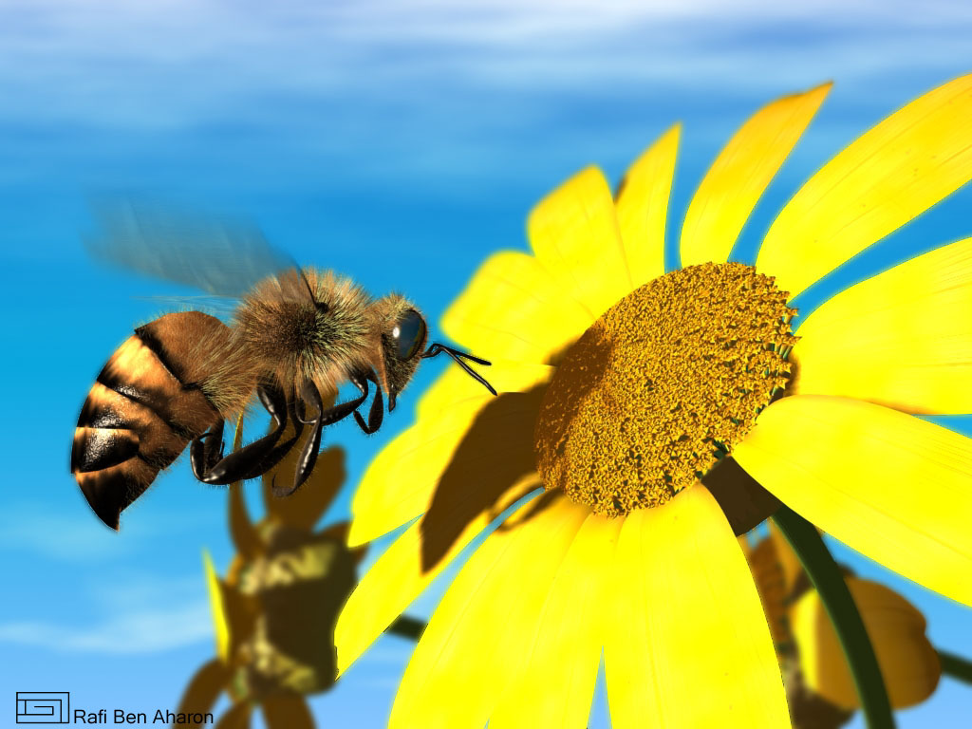
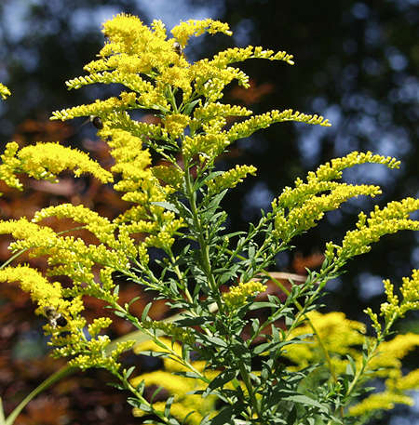
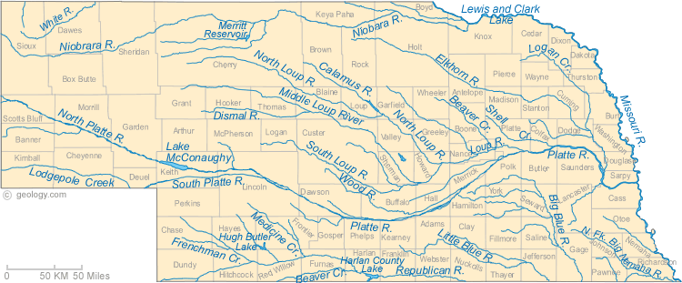
Fun Nebraska Facts
In 1927, Edwin E. Perkins from Hastings, NE, invented Kool-Aid.
The nickname of NE used to be “Tree Planter’s State” but changed to the “Cornhusker State” in 1945.
State Insect: Honeybee
State Flower: Goldenrod
The Reuben Sandwich was invented in NE.
NE has more miles of river than any other state
In 1950, NE became the home of the College World Series.

